Slide 1
Algorand: Scaling Byzantine Agreements for Cryptocurrencies
Team members:
Meng-Huan Lee
Rui Li
Wenyan He
Wei Su
Li Zhang

Slide 2
Outline
Introduction
Techniques used in Algorand:
Gossip protocol
Cryptographic Sortition
Block proposal
BA⋆ algorithm
Main procedure of BA⋆
Conclusion

Slide 3
Introduction
Double-spending is the core problem faced by any cryptocurrency. Bitcoin uses proof-of-work (PoW), where users must repeatedly compute hashes to grow the blockchain, and the longest chain is considered authoritative. However, it takes about an hour to confirm a transaction in Bitcoin.

Slide 4
Introduction continued...
Algorand is a new cryptocurrency that confirms transactions on the order of a minute with a negligible probability of forking while scaling to many users. Algorand uses a new Byzantine Agreement (BA⋆) protocol to reach consensus among users. In Algorand’s BA protocol, users do not keep any private state except for their private keys, which allows Algorand to replace participants immediately after they send a message. It reduces targeted attacks on chosen participants after their identity is revealed.

Slide 5
Techniques used in Algorand:
Gossip protocol
Weighted users
Consensus by committee
Cryptographic sortition
Participant replacement
Block proposal

Slide 6
Gossip protocol
Algorand users communicate through a gossip protocol. The gossip protocol is used by users to submit new transactions. Each user collects a block of pending transactions that they hear about, in case they are chosen to propose the next block.

Slide 7
Cryptographic Sortition
Cryptographic sortition is an algorithm for choosing a random subset of users according to per-user weights.

Slide 8
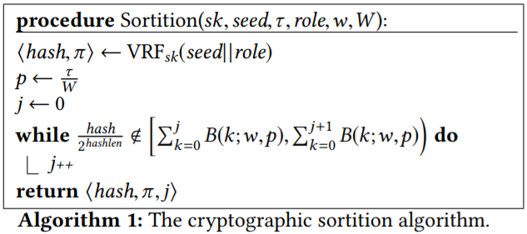
Cryptographic Sortition continued...
Selection procedure:
As shown in Algorithm 1, a user performs sortition by computing ⟨hash,π⟩ ← VRFsk (seed||role), where sk is the user’s secret key.

Slide 9
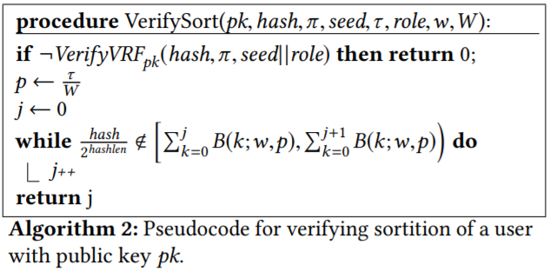
Cryptographic Sortition continued...
Selection procedure:
The pseudocode for verifying a sortition proof, shown in Algorithm 2, follows the same structure to check if that user was selected.

Slide 10
Block Proposal
Minimizing unnecessary block transmissions.
Waiting for block proposals.
Malicious proposers.

Slide 11
BA⋆
The execution of BA⋆ consists of two phases. In the first phase, BA⋆ reduces the problem of agreeing on a block to agreement on one of two options. In the second phase, BA⋆ reaches agreement on one of these options: either agreeing on a proposed block, or agreeing on an empty block.

Slide 12
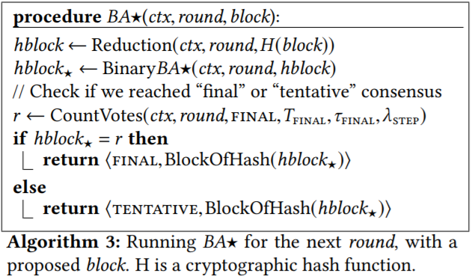
Main procedure of BA⋆
The top-level procedure implementing BA⋆, as invoked by Algorand, is shown in Algorithm 3.
For efficiency, BA⋆ votes for hashes of blocks, instead of entire block contents. The BA⋆algorithm also determines whether it established final or tentative consensus.

Slide 13
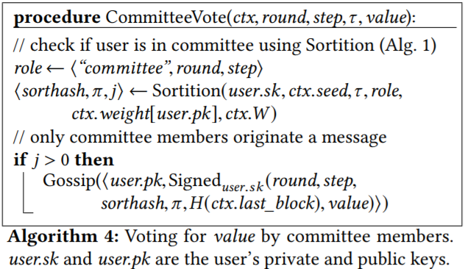
⋆Main procedure of BA⋆: Voting
Sending votes (Algorithm 4). Algorithm 4 shows the pseudocode for CommitteeVote(), which checks if the user is selected for the committee in a given round and step of BA⋆.

Slide 14
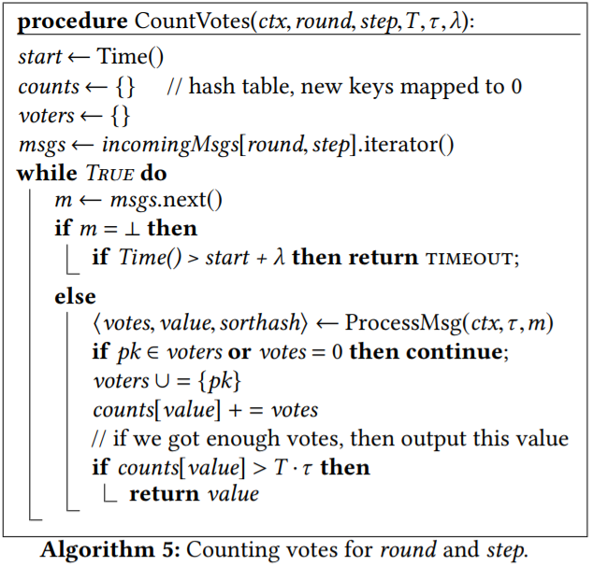
⋆Main procedure of BA⋆: Voting
Counting votes (Algorithm 5 and Algorithm 6).
The CountVotes() procedure (Algorithm 5) reads messages that belong to the current round and step from the incomingMsgs buffer.

Slide 15
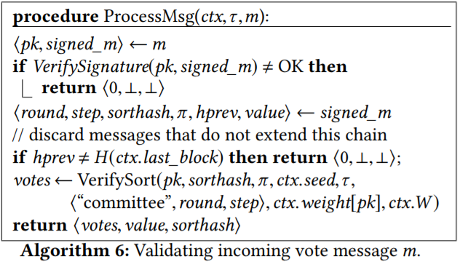
⋆Main procedure of BA⋆: Voting
It processes the votes by calling the ProcessMsg() procedure for every message (Algorithm 6), which ensures that the vote is valid.

Slide 16
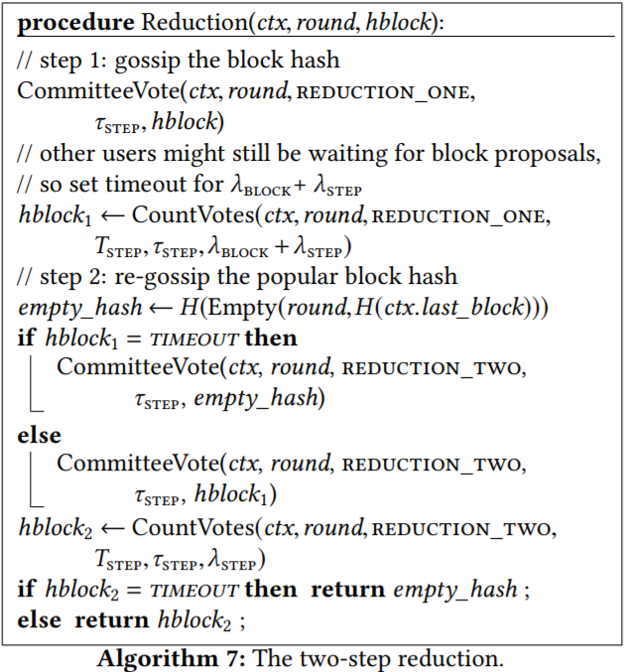
⋆Main procedure of BA⋆: Reduction
The Reduction() procedure, shown in Algorithm 7, converts the problem of reaching consensus on an arbitrary value (the hash of a block) to reaching consensus on one of two values: either a specific proposed block hash, or the hash of an empty block.

Slide 17
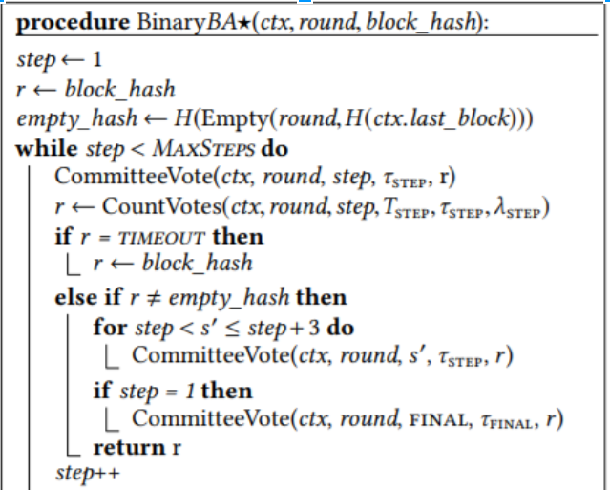
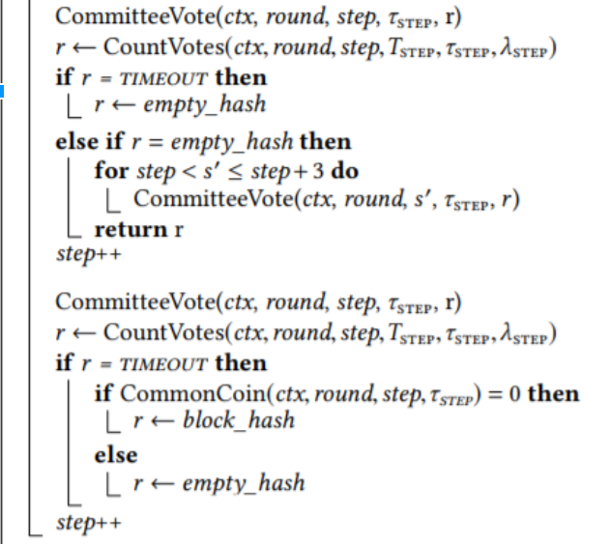
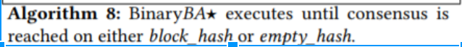
⋆Main procedure of BA⋆: Binary agreement
Algorithm 8 shows BinaryBA⋆(), which reaches consensus on one of two values: either the hash passed to BinaryBA⋆() or the hash of the empty block.

Slide 18
BA⋆ continued: Committee size
The fraction h > 2/3 of weighted honest users in Algorand must translate into a “sufficiently honest” committee for BA⋆. BA⋆ has two parameters at its disposal: τ , which controls the expected committee size, and T , which controls the number of votes needed to reach consensus (T ·τ). We would like T to be as small as possible for liveness, but the smaller T is, the larger τ needs to be, to ensure that an adversary does not obtain enough votes by chance.

Slide 19
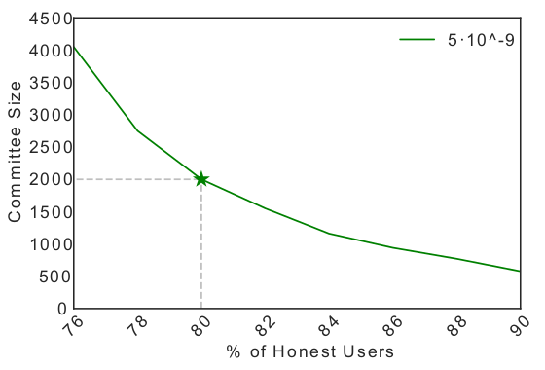
BA⋆ continued: Committee size
Committee size, τ, that is sufficient to limit to 5x10^(-9) the probability of violating certain constraints
Horizontal axis specifies weighted fraction of honest users, or fraction of money held by honest users

Slide 20
Conclusions
A new cryptocurrency with low latency and high scalability
Based on a Byzantine agreement protocol called BA*
Grows a blockchain in async rounds
Algorand users execute crytographic sortition using VRFs to determine if they are selected to propose a block
Uses BA* to reach consensus on a pending block
BA* executes in two phases: Reduction( ), BinaryBA*( )
BA* produces two types of consensus: final, tentative
Efficient: for a strongly sync network, consensus reached in 4 steps (or 13 steps)

Slide 21
References
http://www.scs.stanford.edu/17au-cs244b/sched/readings/algorand.pdf
https://blog.csdn.net/sanganqi_wusuierzi/article/details/78846430
https://github.com/fractalide/fractalchains
https://www.jianshu.com/p/900374cd7eab
https://blog.csdn.net/omnispace/article/details/79653972
https://blog.csdn.net/turkeycock/article/details/81316249
https://github.com/peitalin/algorand-rust
https://eprint.iacr.org/2018/377.pdf

Slide 22
THANK YOU

